Slide 1
UNFCCC COP24 Side-event
Katowice, Poland
08 December 2018
Triangular co-operation to achieve ambitious climate action and sustainable development solutions

Slide 2
An emerging definition of triangular co-operation
What is triangular co-operation?
Various understandings of triangular and trilateral co-operation

Slide 3
Budget average is around USD 2 million

Slide 4
Triangular co-operation projects last on average almost 2 years

Slide 5
Triangular co-operation is happening in many sectors

Slide 6
Most (reported) triangular co-operation projects happen in Latin America and the Caribbean

Slide 7
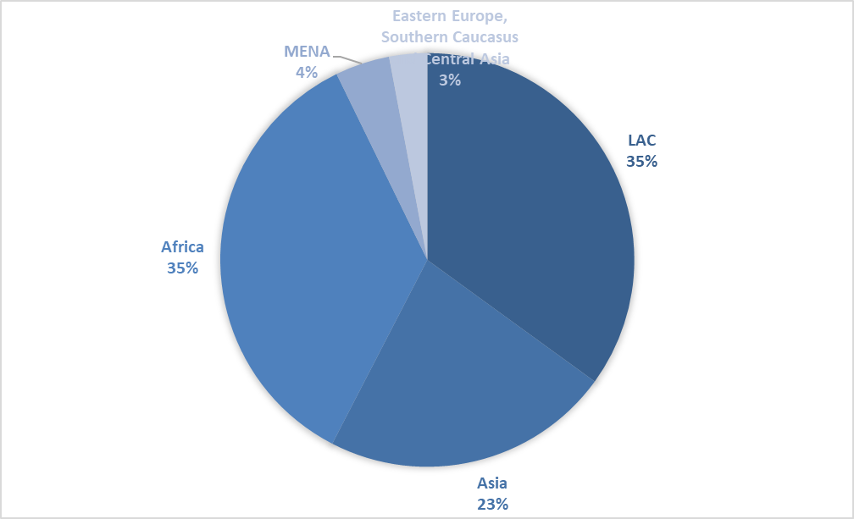
Main characteristics of ‘green’ triangular co-operation
Top providers of green triangular co-operation:
Germany, Mexico, Japan, Brazil, China, Chile, Kenya, Costa Rica, Mozambique and Peru
These 10 countries account for about 30% of all green triangular co-operation (2014-18)
Average project duration: 3 years (about 27% of the cases)
Average budget: between USD 1 and USD 5 million
Main sectors:
agriculture, energy, water and sanitation
Main regions >>>>

Slide 8
And what about “green” triangular co-operation?
And what about “green” triangular cooperation (SDGs 13, 14, 7, 11 and 12)?
Target area of the triangular co-operation activity | Projects where this is the ‘principal’ objective | Projects where this is a ‘secondary’ objective
Local Environment | 29.6% | 10.7%
Climate Change Adaptation or Mitigation | 26.7% | 14.1%
Biodiversity | 13.6% | 4.3%
Desertification | 1% | -
TOTAL | 70.9% | 29.1%

Slide 9
Advantages of green triangular co-operation
  Triangular co-operation promotes:
  Trusting, stable and horizontal partnerships
  Partners’ complementary strengths to achieve development results.
  Knowledge-sharing
  Co-created solutions to development challenges that are innovative, affordable and context-specific.
  Additional resources and institutions to enhance the volume, scope and sustainability of trilateral co-operation projects.
  More effective development co-operation, regional integration and shaping a common understanding of international development.

Slide 10
Further information
For further information including:
OECD reports and factsheets on triangular co-operation.
Summaries of meetings and side events organised by the OECD.
Please visit our website at:
http://www.oecd.org/dac/dac-global-relations/triangular-cooperation.htm
Literature repository, with over 100 documents:
http://www.oecd.org/dac/dac-global-relations/triangular-co-operation-library.htm
On-line project repository, with information on over 420 projects:
http://www.oecd.org/dac/dac-global-relations/triangular-co-operation-repository.htm

Slide 11
Juan Casado-Asensio
Policy Analyst – DAC Global Relations
Development Co-operation Directorate
E-mail: juan.casadoasensio@oecd.org
Thank you!

