Slide 1

The FAO International Sustainable Bioeconomy Working Group
Anne Bogdanski, Natural Resources Officer and Bioeconomy Coordinator, FAO
Marta Gomez San Juan, Bioeconomy Adviser, FAO
Unossc webinar Fostering South-South cooperation on nature-based solutions for a low-emission and climate-resilient recovery
23 September 2020, 08:30 – 10:00 hrs (New York time)

Slide 2
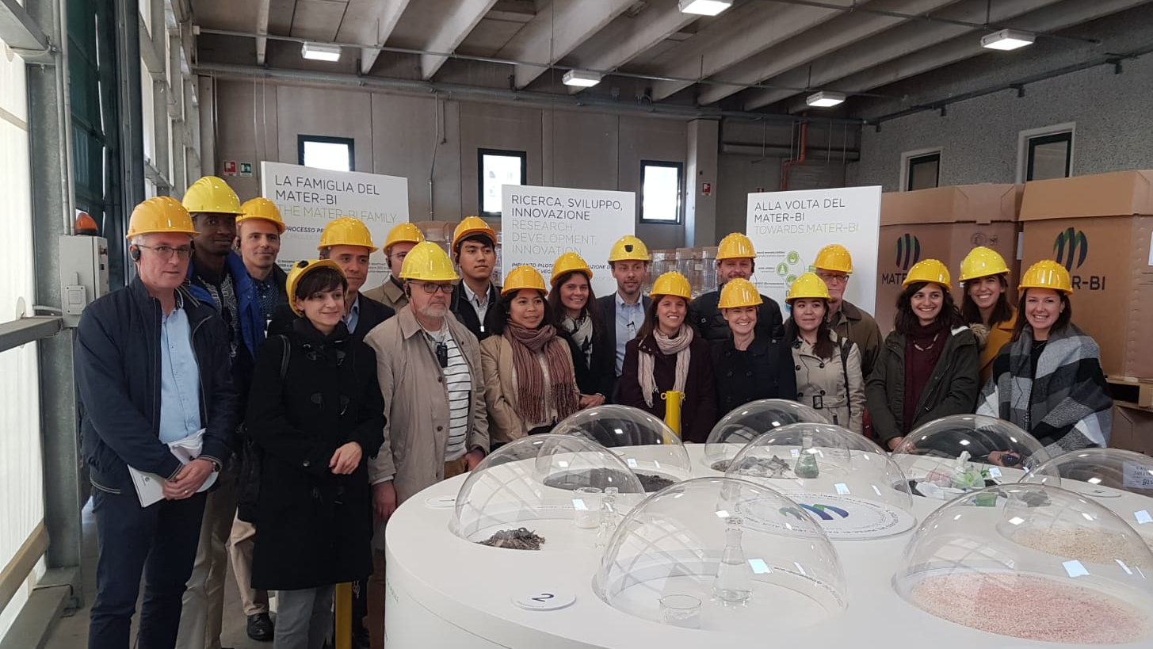
isbwg a multi-stakeholder platform
Led by FAO, as recommended by the 2015 Global Forum for Food and Agriculture
Formed by 35 members: countries, regions, researchers and innovators, the private sector, NGOs and international organizations
All continents represented
Notes:
Thanks for inviting us –I am here on behalf of an international COP………
The mechanism led by FAO facilitates knowledge-
and experience-sharing on synergies and trade-offs in
bioeconomy and opportunities for sustainability and circularity
to support countries in decision-making processes.
The group is consulted often tO give inputs to FAO‘s work on circular bioeconomy
For easy of reference:
14 national governments, 3 regional governing bodies, 6 research and innovation institutions, 2 civil society organizations, 4 private sector entities and public-private partnerships, 4 intergovernmental organizations
14 national governments (Argentina, Brazil, Canada, China, Finland, France, Germany, Italy, Malaysia, Namibia, Netherlands, South Africa, Uruguay and the United States of America), 3 regional governing bodies and affiliated institutions (the European Commission, the Nordic Council of Ministers and Inter-American Institute for Cooperation on Agriculture), 2 civil society organizations (the Amazonas Sustainable Foundation and World Wildlife Fund), 4 private sector entities and Public-private partnerships (PPPs): (The Bio-Based Industries Joint Undertaking between the European Commission and the Bio-based Industries Consortium, The World Business Council for Sustainable Development, The Advisory Committee on Sustainable Forest-based Industries and World Business Council For Sustainable Development), 6 research institutions (The International Center for Tropical Agriculture, The Brazilian Agricultural Research Corporation, The Stockholm Environment Institute, Wageningen University, University of Bonn Center for Development Research, University of Bologna and New Zealand Forest Research Institute (Scion)) and 4 intergovernmental organizations (The Food and Agriculture Organization, The Organization for Economic Co-operation and Development, The United Nations Economic Commission for Latin America and the Caribbean and The United Nations Environment Programme).

Slide 3
supporting national AND REGIONAL policy makers in the bioeconomy space
The Group and the FAO project “Towards Sustainable Bioeconomy Guidelines” support knowledge exchange between its members on transitioning to a sustainable and circular bioeconomy. This includes, but is not limited to:
Better understanding the potential benefits and risks of bio-innovations through lessons learnt and good practices.
Providing guidance to national and regional stakeholders in the development of sustainable and circular bioeconomy strategies.
Supporting bioeconomy monitoring and evaluation toward a sustainable economy.
Notes:
Policy development: a platform for countries and regions to share knowledge and experience on transitioning to a sustainable and circular bioeconomy
The ISBWG is a South-South and Triangular Cooperation (SSTC) platform as it provides knowledge and experience-sharing related to bioeconomy-relevant good practices, monitoring systems and tools.
ISBWG is a unique and innovative international platform, as it builds national capacities in
drafting policies for sustainability and circularity in the bioeconomy.
For instance: A draft National Bioeconomy Vision and Strategy was developed in Uruguay, with
the support of FAO. Uruguay also benefited from the lessons
learned, instruments used and challenges faced by other ISBWG countries in developing and implementing bioeconomy
strategies. The exchange with international partners provided understanding of the relevant synergies and trade-offs. As a
result, the draft vision and strategy includes many considerations for sustainability and circularity, such as integrating
biodiversity values into the systemic utilization of biological
Resources.

Slide 4

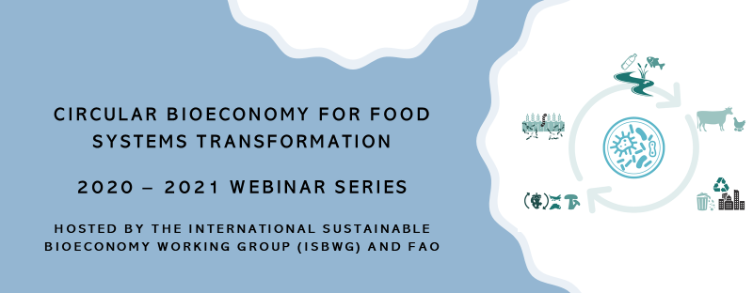
Notes:
Focus on the food sector (the biggest share of bioeconomy)
Annual physical meeting – This year a series webinars: A view towards the Food Systems Summit 2021 https://www.un.org/sustainabledevelopment/food-systems-summit-2021/
– opportunities for FS transformation. Also, knowledge exchange on potential trade-offs and risks

Slide 5
Circular bioeconomy and nature-based solutions
The ISBWG is an example of South-South and Triangular Cooperation as it provides knowledge and experience-sharing on bioeconomy and nature-based solutions:
Good practices, monitoring systems and tools are key for providing information and data on making economies more resilient to global pandemics like COVID-19.
Concrete bioeconomy measures can be used in recovery plans to lessen the impacts from the triple challenge of climate change, air pollution and the COVID-19 pandemic and prevent future pandemics.
Notes:
To date, there is some South-South
and triangular cooperation (SSTC) networks related to bioeconomy,
such as the Latin American Bioeconomy Network,
the EU-South Africa led International Bioeconomy Forum, the
BioInnovate programme in Africa, or the German-led International
Advisory Council on Bioeconomy. Different networks
have different objectives. The uniqueness of the FAO ISBWG
is that it advocates for the sustainable transformation of food
systems through a circular bioeconomy.

Slide 6

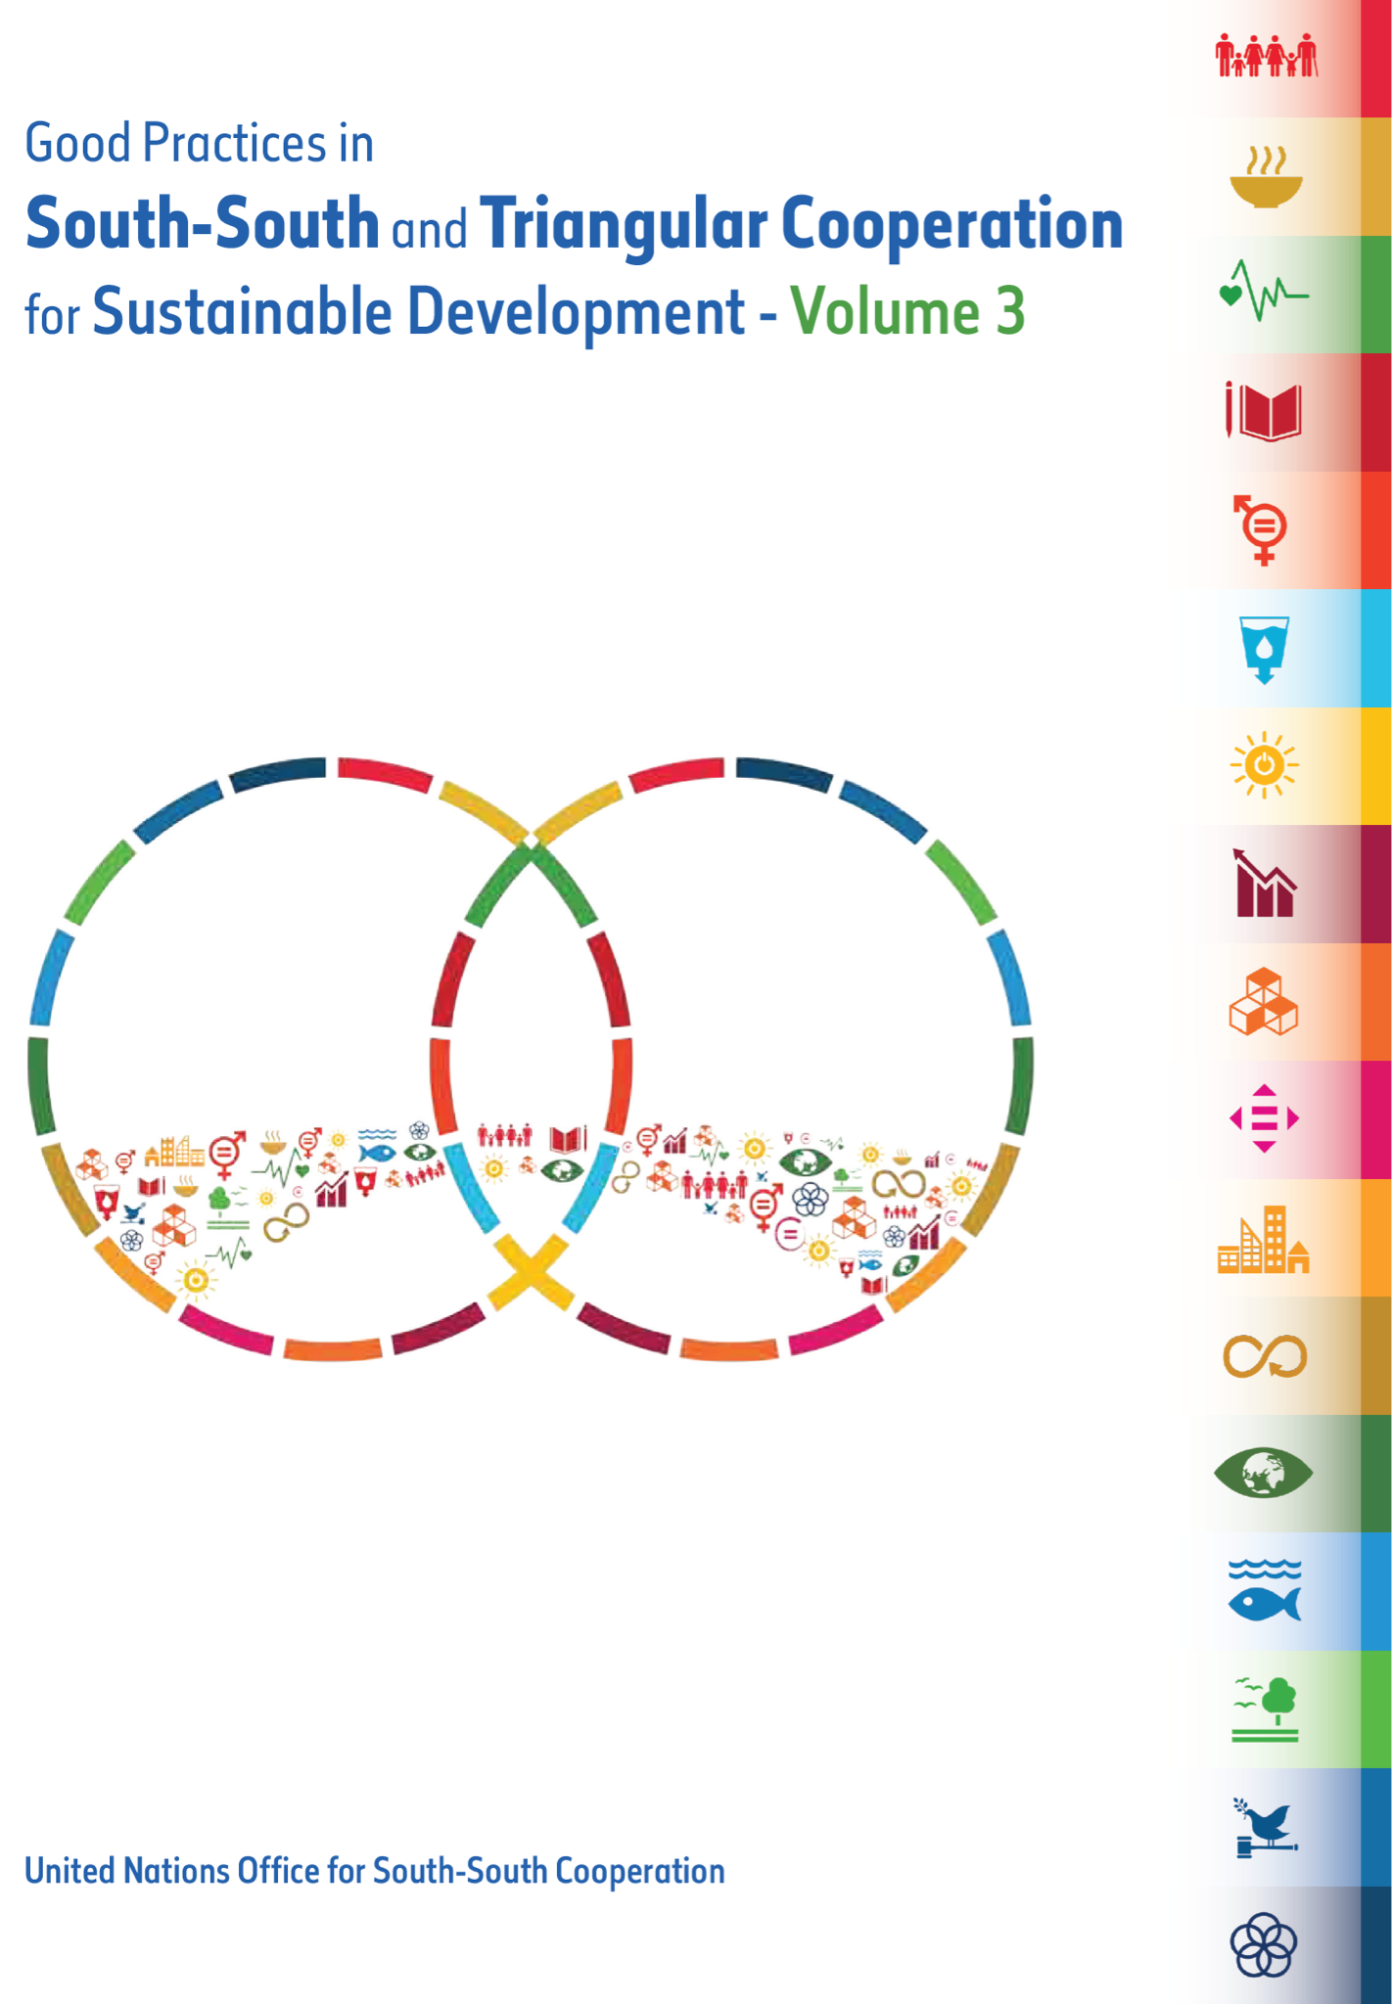
THE ISBwg AND FAO’s WORK ON CIRCuLAR BIOECONOMY: a successful south-south cooperation example presented at THE UN CLIMATE CHANGE CONFERENCE - cop 25, MADRID

Slide 7
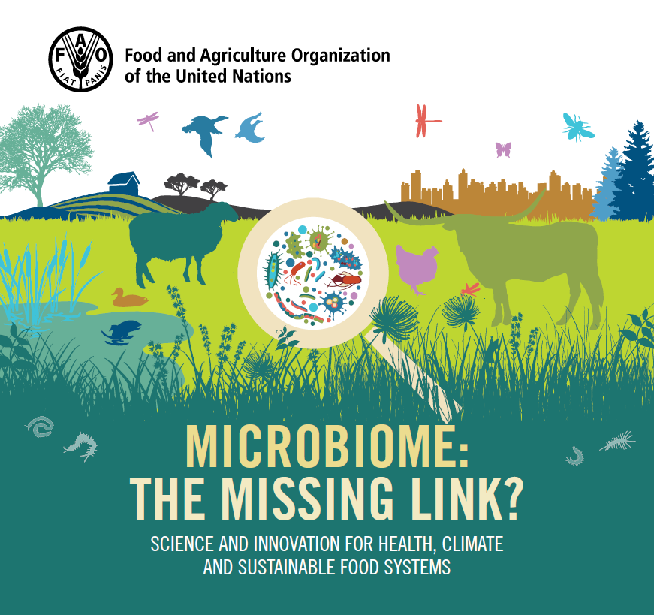
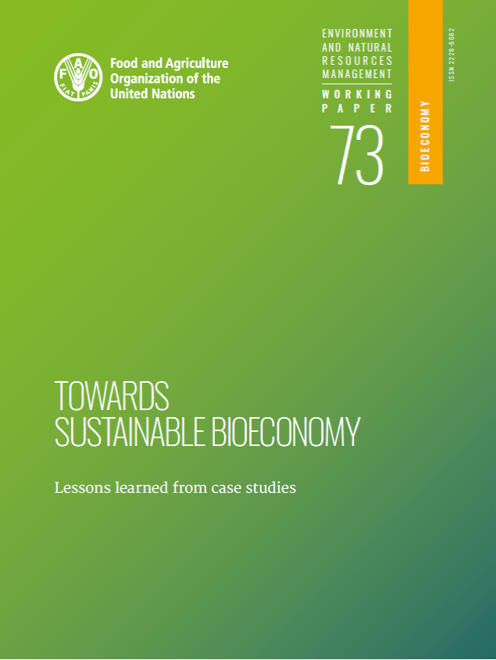
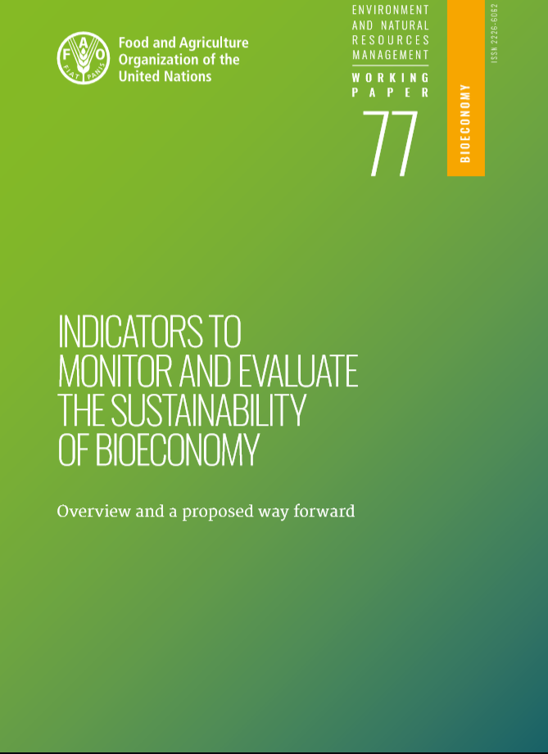
THANK you For YOUR Attention!
Contacts:
Annekatrin.Bogdanski@fao.org
Marta.GomezSanJuan@fao.org
http://www.fao.org/climate-change/our-work/areas-of-work/bioeconomy/en/
http://www.fao.org/3/ca6767en/CA6767EN.pdf
http://www.fao.org/3/ca4352en/ca4352en.pdf
http://www.fao.org/3/ca6048en/ca6048en.pdf

