Slide 1
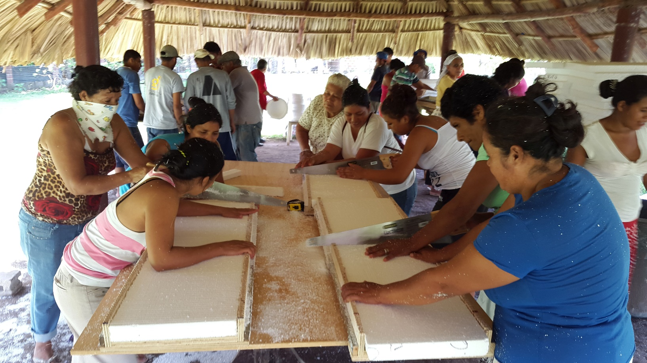
South-South & Triangular Cooperation
Yoko Watanabe, Global manager,
GEF Small grants Programme, UNDP

Slide 2
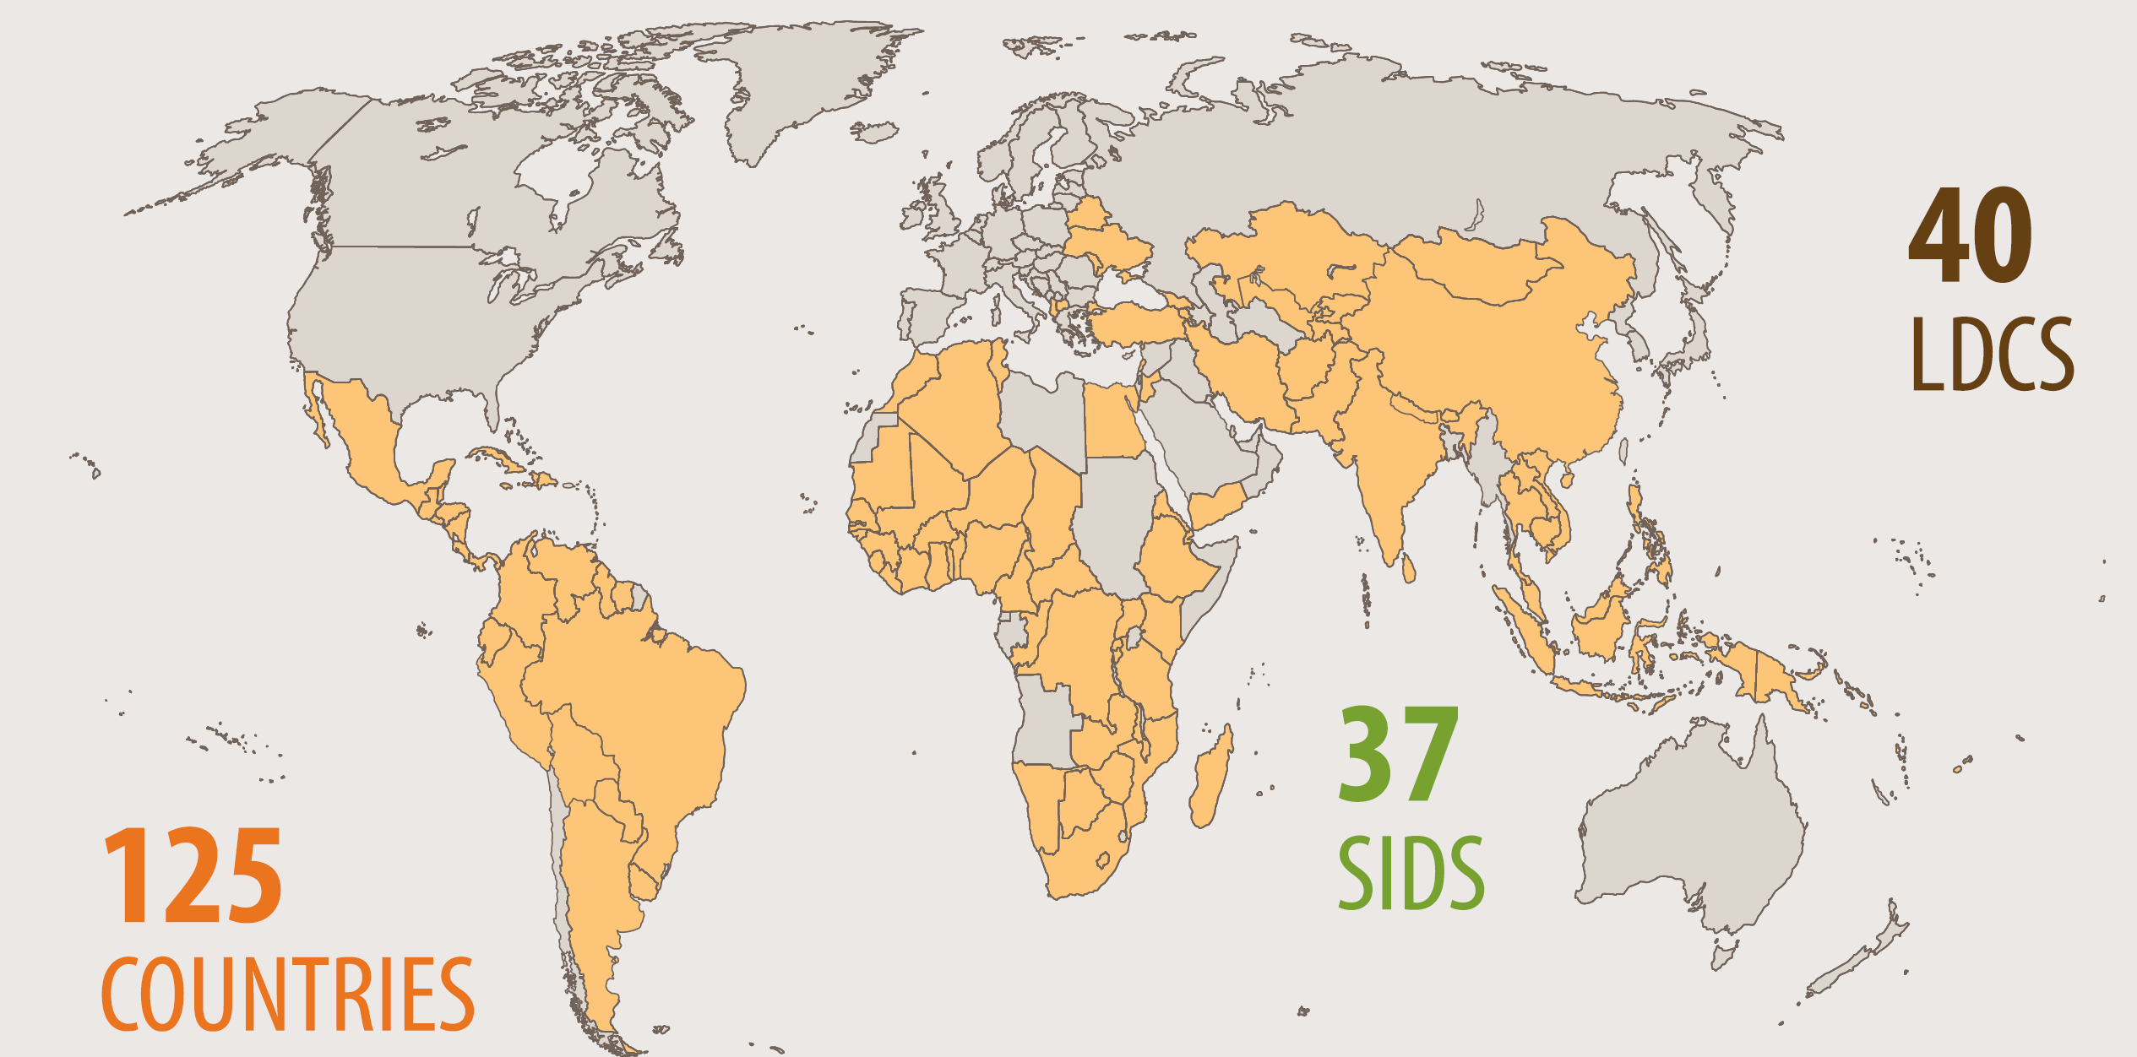
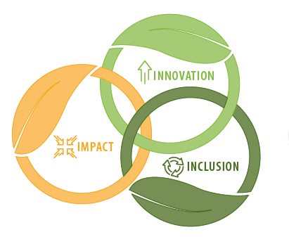
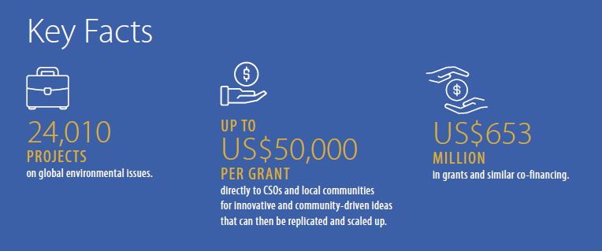
Small Grants Programme
Local solutions to global environmental problems
Supports innovative community-based initiatives and actions
Since 1992, GEF Corporate Program, implemented by UNDP

Slide 3
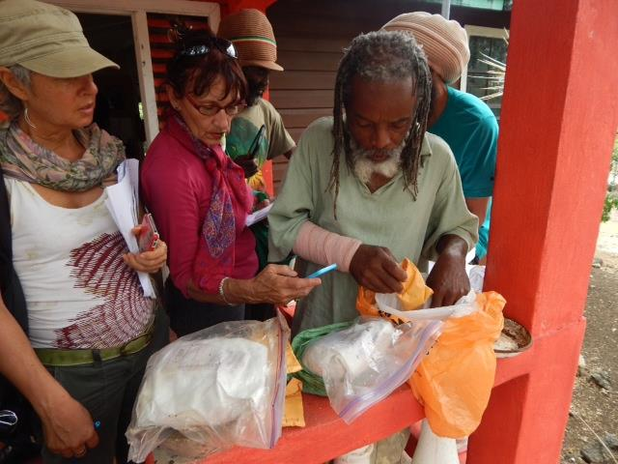
SGP South–South Community Innovation Platform
What:
  Promote replication and upscaling of good practices on global environmental issues/nature-based solutions across SGP countries and regions
  Promote knowledge exchange between SGP countries and encourage cross country/region replication of good practices.
How:
  Peer-to-peer, in person exchange among civil society and community-based organizations at the regional and global level, to learn and apply effective local solution, including technology, tool and practice.

Slide 4
Launch of Innovation Programme on South-South Cooperation
Eco-tourism - Colombia, Panamá, Costa Rica
Apiculture - Argentina, Paraguay, Uruguay
Apiculture - Dominica, Grenada, Saint Kitts & Nevis, Saint Vincent and the Grenadines, Samoa, Trinidad and Tobago and Saint Lucia
Empowerment of the San Indigenous peoples – using Indigenous knowledge on sustainable agriculture and herbal medicine: Botswana, Namibia and South Africa
Plastics management - Honduras, Cuba, El Salvador, Belize and Samoa –
Initiative Climat - Burkina Faso, Morocco, and other Francophone African countries
Seaweed cultivation, processing and valued- added products - Belize and Mauritius -
Climate-smart Agriculture - Ghana, Liberia and Sierra Leone-
Artisanal and Small Scale Mining - Ghana, Mali, Guinea and Burkina Faso
Snow leopard conservation – China and snow leopard range countries

Slide 5
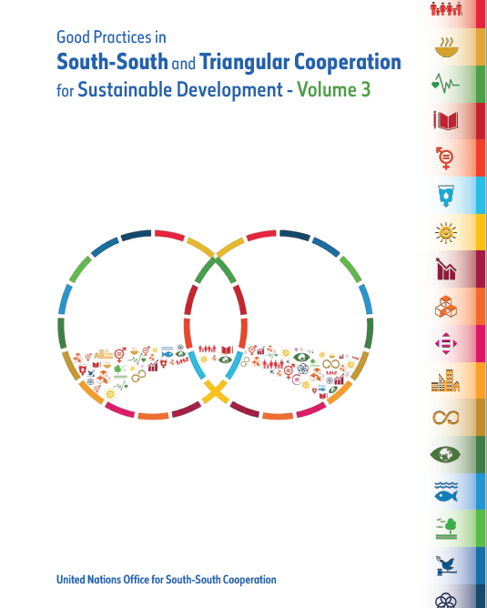
Good Practices Cases
Fiji Rocket Stoves Initiative for the Empowerment of Rural Woman
Joint Efforts to an Innovative Programme for Persons with Disabilities: Ukraine and Belarus
Sustainable Agriculture and Food Security with Aquaponics Technology – Jamaica and Mexico
South-South Cooperation on Climate Change in Francophone Africa

Slide 6
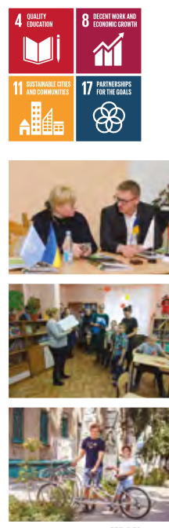
Case: “Nothing for us, without us”
Engaging persons with disabilities on climate change and nature-based solutions
S-S exchange among local communities and CSOs from Ukraine and Belarus.
Share good practices and lessons of Belarus on renewable energy use and biodiversity-friendly social business promotion.
Replicated in Ukraine:
  Solar powered energy use for public facilities for PwD.
  Engagement of PwD in environmental and social businesses, including beeswax and pottery.
  Development of guidelines on environmentally friendly social entrepreneurship for communities, social inclusion and eco-tourism, etc.
Continued exchange through regular follow up digital workshops and peer-to-peer events.

Slide 7
THANK YOU
Contacts:
Yoko Watanabe, Global Manager
(yoko.watanabe@undp.org)

