Slide 1

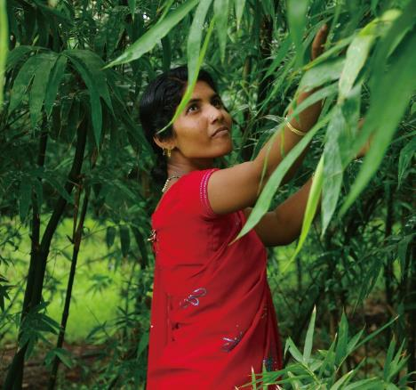
Bamboo: a natural climate solution in the Global South UNOSSC webinar | 23 Sept 2020
Charlotte King
International Bamboo and Rattan Organisation

Slide 2
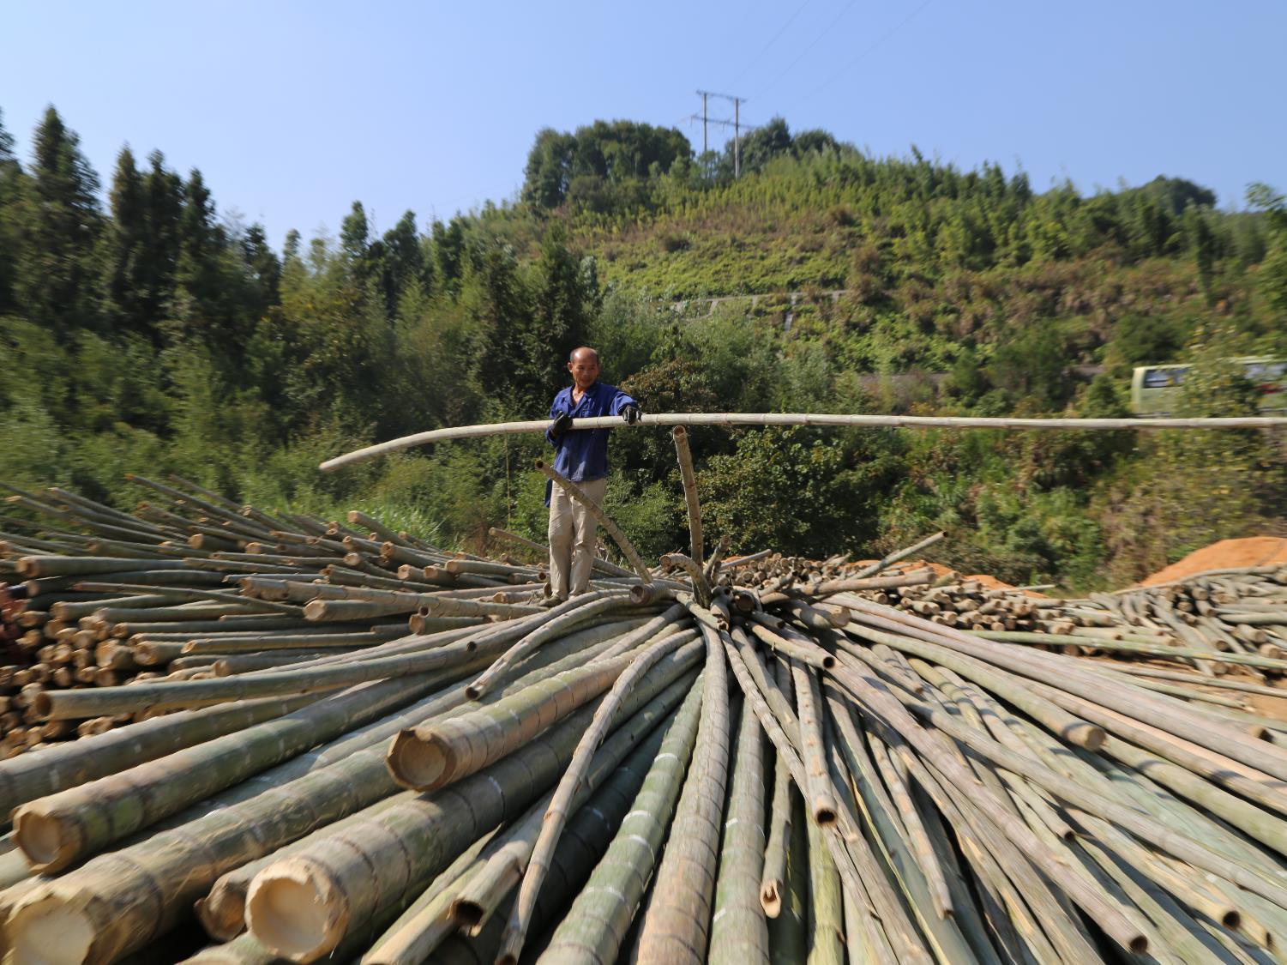

“Why bamboo?”
A common resource to the Global South
Fast-growing, versatile
Used for thousands of years

Slide 3
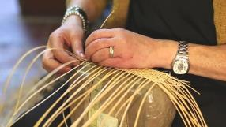
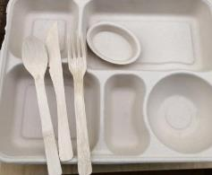


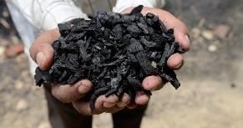
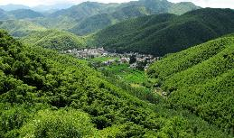
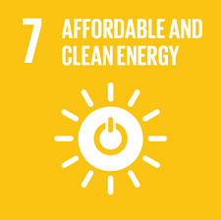

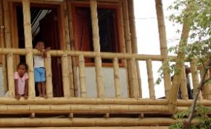
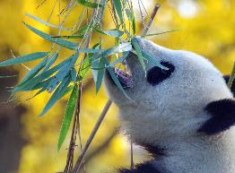


Bamboo: a nature-based solution
“Nature-based solutions: actions to protect, sustainably manage, and restore ecosystems, that simultaneously… provide human well-being and biodiversity benefits” - IUCN
Source of income for millions of people
Low-carbon and easily renewable
plastic alternative
Affordable,
renewable energy:
firewood, charcoal, gas, pellets
Bamboo plants and products can store more carbon than certain types of tree
Important ecosystem services, + source of food & habitat
Sustainable & resilient housing

Slide 4

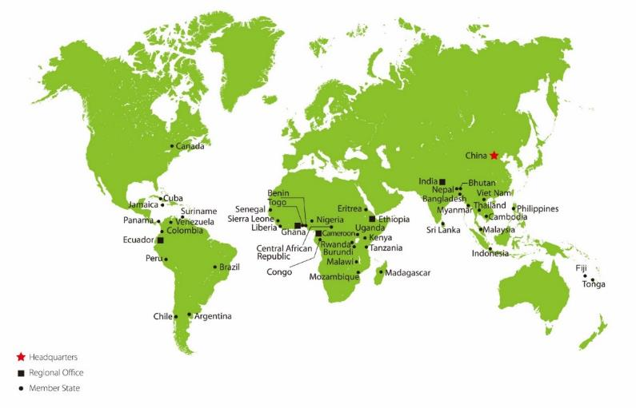
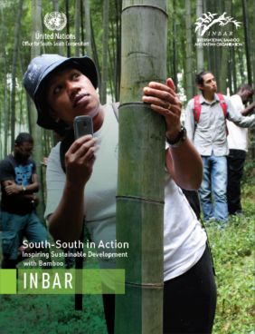
INBAR: a network for South-South cooperation
South-South in Action: Inspiring Sustainable Development with Bamboo (UNOSCC-INBAR report, 2017)
Founded 1997; the ‘UN of bamboo’
47 Member States; 46 from the Global South
40,000 people trained
Projects, research and study visits conducted in 50+ countries

Slide 5
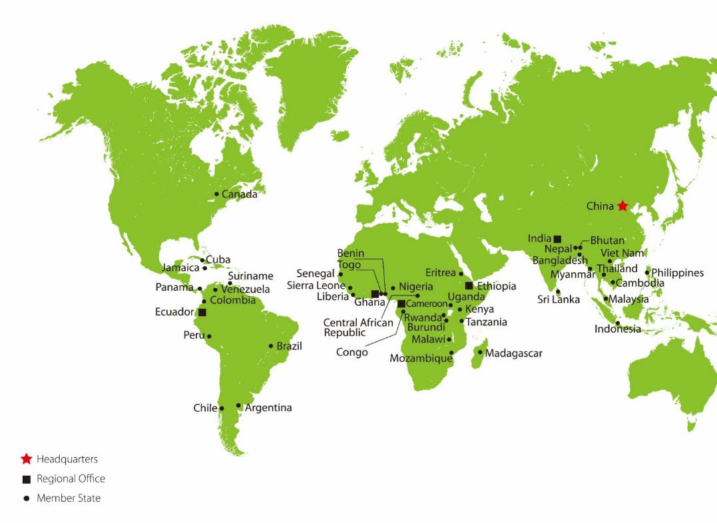
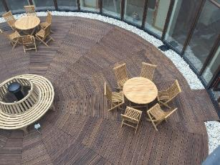
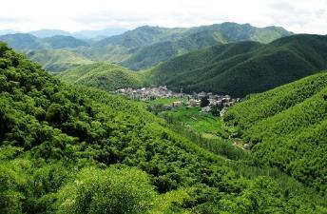
Dutch-Sino-East Africa Bamboo Development Programme
Programme funded by IFAD, 2016-2023
China: bamboo market leader; bamboo for poverty alleviation, reforestation & environmental protection
Netherlands: private sector experience of high-value product creation
Ethiopia, Kenya, Uganda: 3-4% world’s bamboo, but underdeveloped sector
Aims: build climate resilience, strengthen bamboo value chains, build capacity

Slide 6
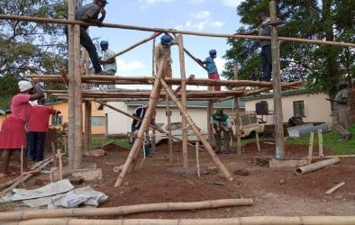
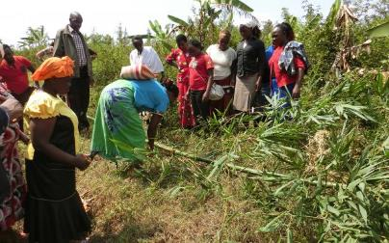
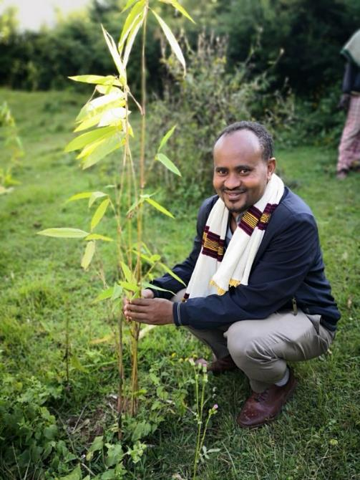
So far: the Dutch-Sino-East Africa Bamboo Development Programme
Bamboo construction training in Kenya; propagation workshop in Uganda
South-South and triangular cooperation ‘in action’:
Resource assessments for bamboo w/ Chinese expertise
Built capacity & transferred technology
Conferences at Wageningen University & in China
Built market links to Europe
New China-Africa Bamboo centre; Bamboo Strategies developed by the governments of Ethiopia, Kenya and Uganda; important COVID-19 livelihood option
Bamboo planting in Ethiopia

Slide 7



Thank you!
www.inbar.int
#thinkbamboo
Charlotte King
cking@inbar.int | @_chakin

