Slide 1
South-South Cooperation on Climate Action
South-South cooperation on nature-based solutions for a low-emission and climate-resilient recovery

Slide 2
Viet Nam: Pyrolysis of coffee husks
30-50% of weight of coffee produced => waste
Using coffee husks in pyrolysis (thermochemical decomposition of organic material at elevated temperatures in the absence of oxygen)
Heat generation => savings of fossil fuel, GHG emission reductions
Residual char = soil conditioner
South-south cooperation to transfer to other coffee dependent economies to address solid waste management, fossil fuel consumption and declining soil fertility
Increased resilience to global pandemics like COVID-19

Slide 3
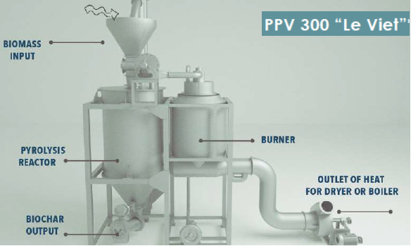
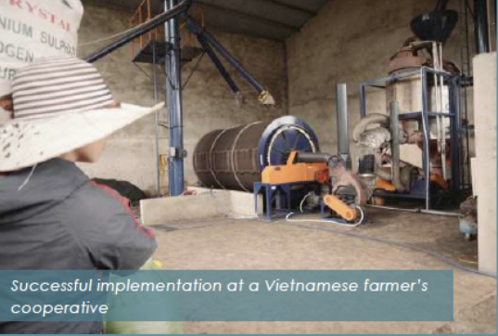
Viet Nam: Pyrolysis of coffee husks

Slide 4
Montenegro: Reed Bed Filter for Sludge Treatment
Using the potential of Phragmites comunis to dewater (2% => 50% solid matter) and reduce volume of sludge to 1/10
Composting of sludge
Energy savings, no need for chemicals, compost can be used as soil conditioner/fertilizer, circularity
Master Plan Lake Modrac, pilot constructed wetland
South-south for up-scaling and roll out

Slide 5
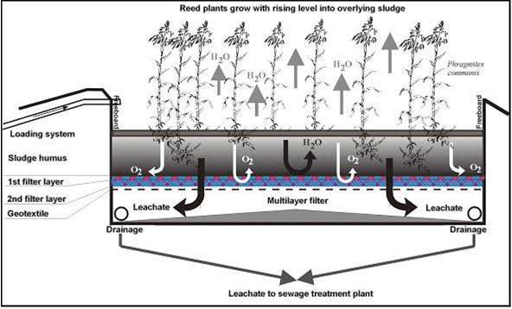
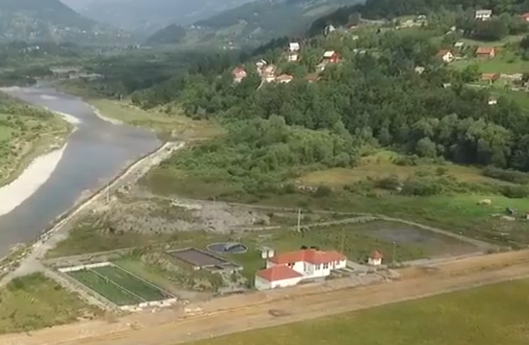
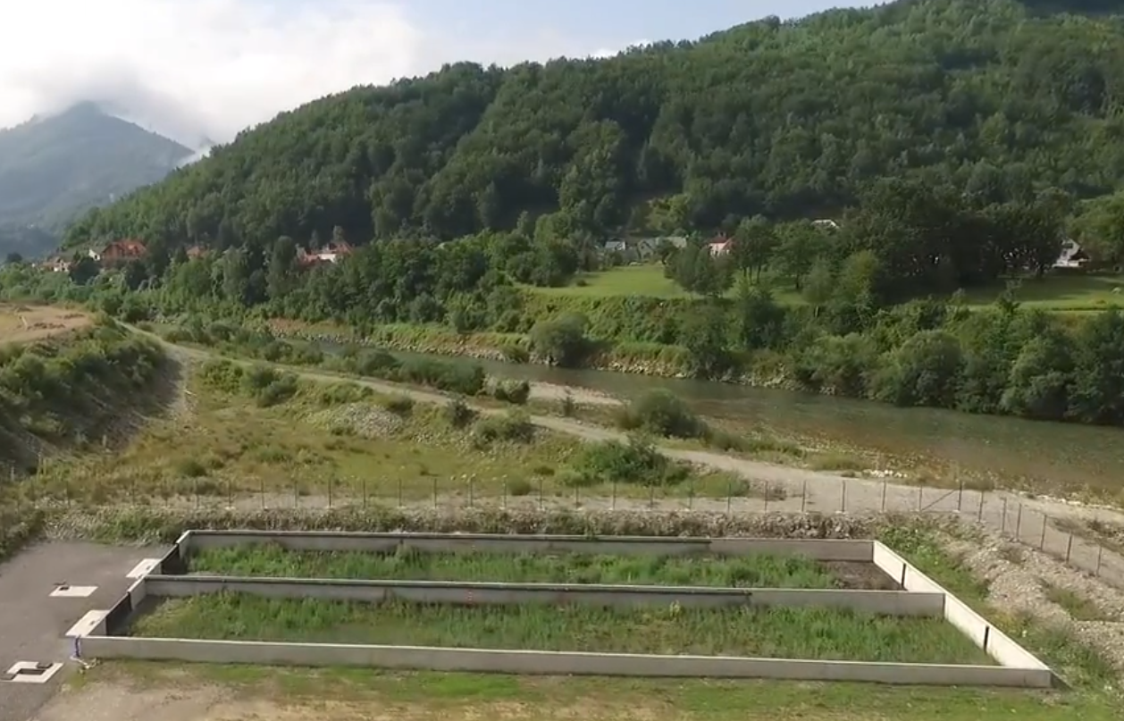
Montenegro: Reed Bed Filter for Sludge Treatment

Slide 6
Indonesia: PPP on water stewardship
Water scarcity limits sustainable development
Land degradation and deforestation drives water scarcity
Stakeholder engagement process
Agroforestry, bamboo plantations, absorption wells

Slide 7
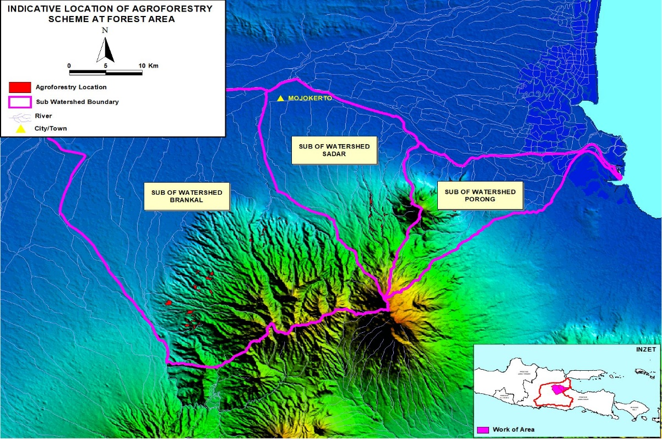
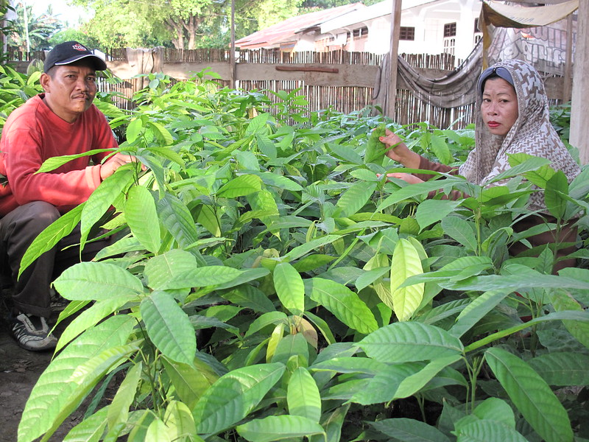
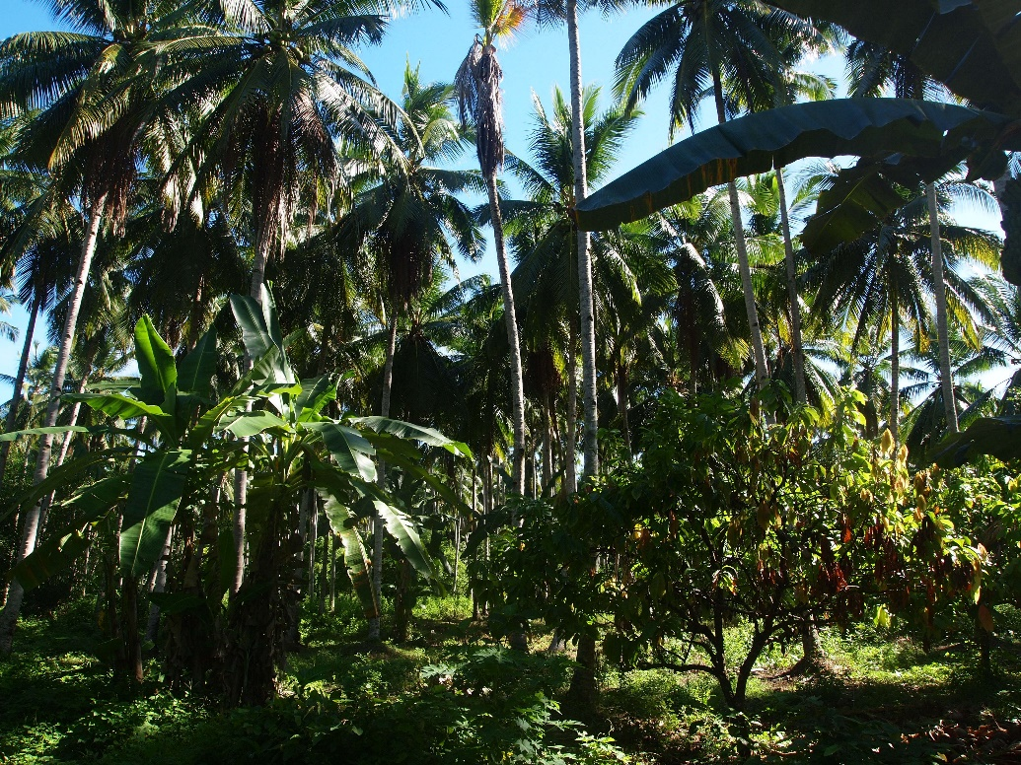
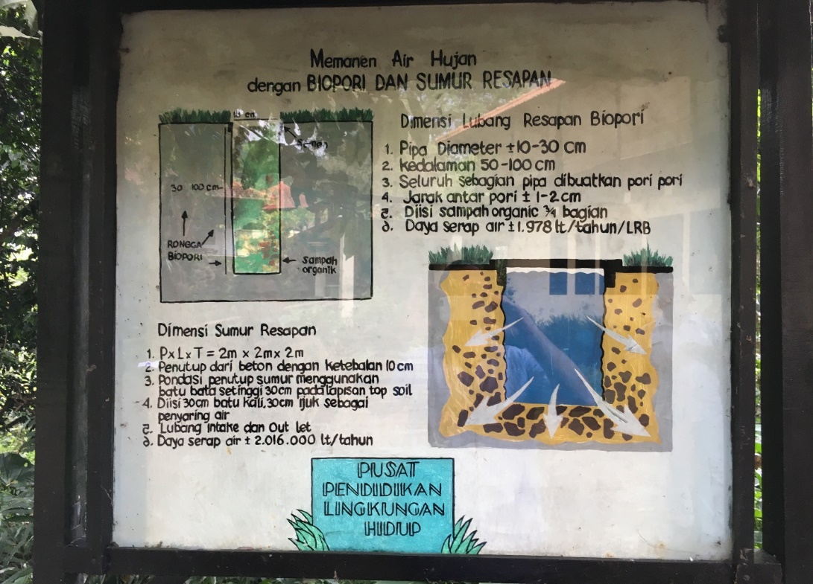
Indonesia: PPP on water stewardship

Slide 8
Nature Based Solutions – the Business Case
Using systemic approaches and simulation to scale nature-based infrastructure for climate adaptation (GEF/UNIDO/IISD)
Simulation of impacts of NBI on ecosystem services
Cost comparison
Economic valuation of positive externalities
Disseminate information on the superiority of NBI to inform decision makers

Slide 9
Thank you!
For more information, please contact:
Christian Susan c.susan@unido.org

